Slide 1
Building Your First App with Spring Boot and Angular
CREATING THE SPRING BOOT PROJECT

Slide 2
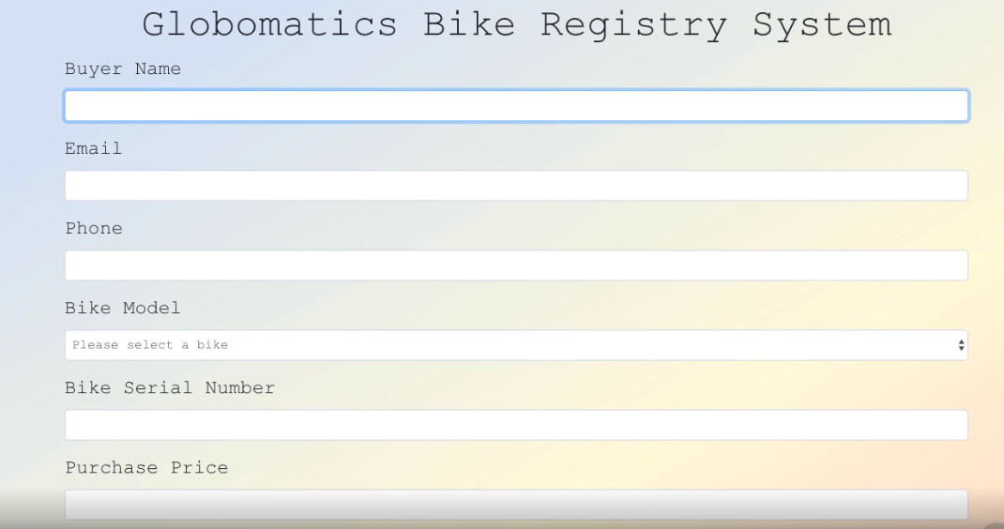

Slide 5

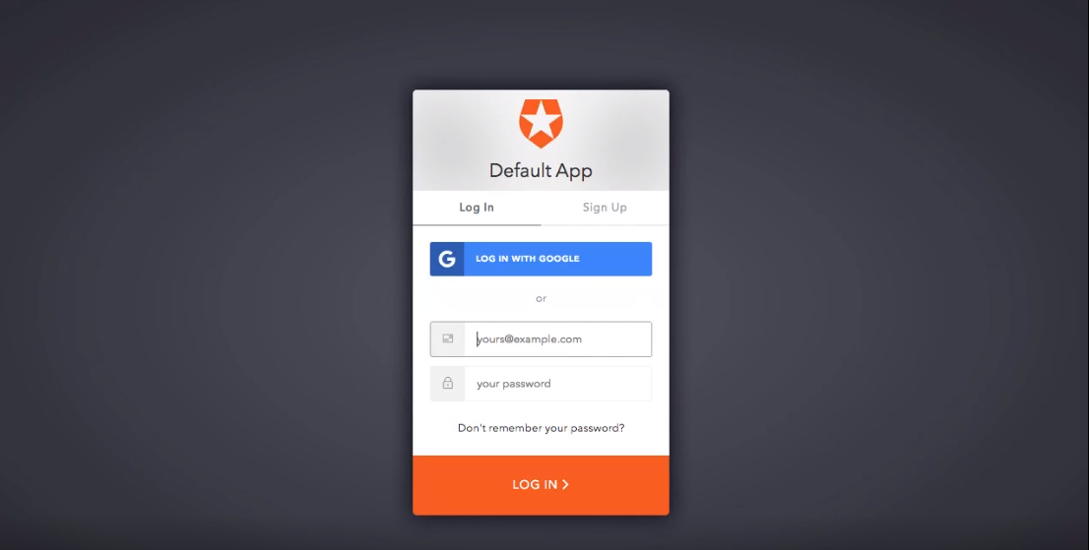

Slide 6
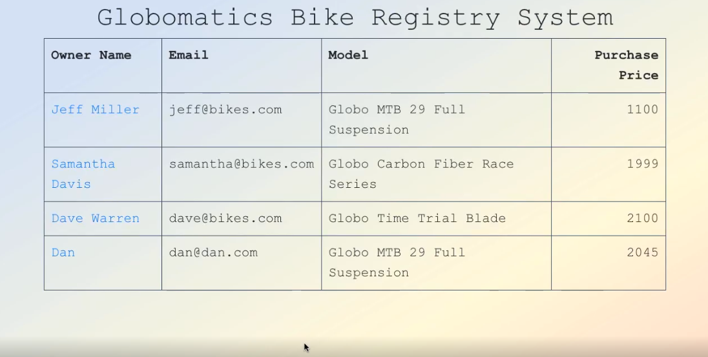
Admin Screen

Slide 7
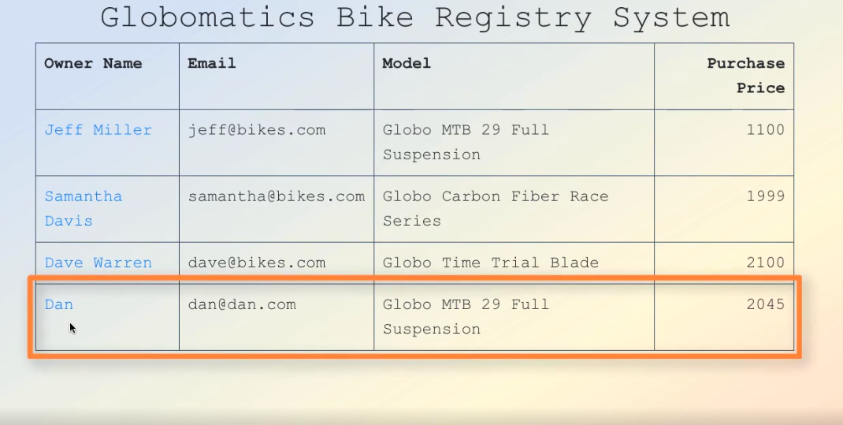
Click on an Owner Name

Slide 8
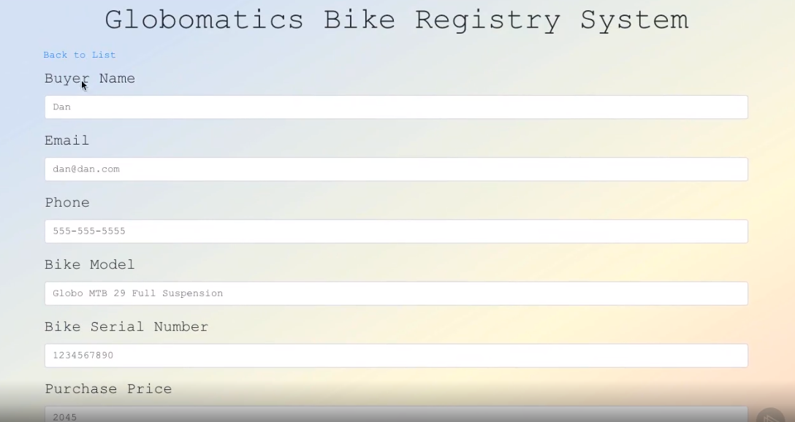
Details of Purchase Screen

Slide 9
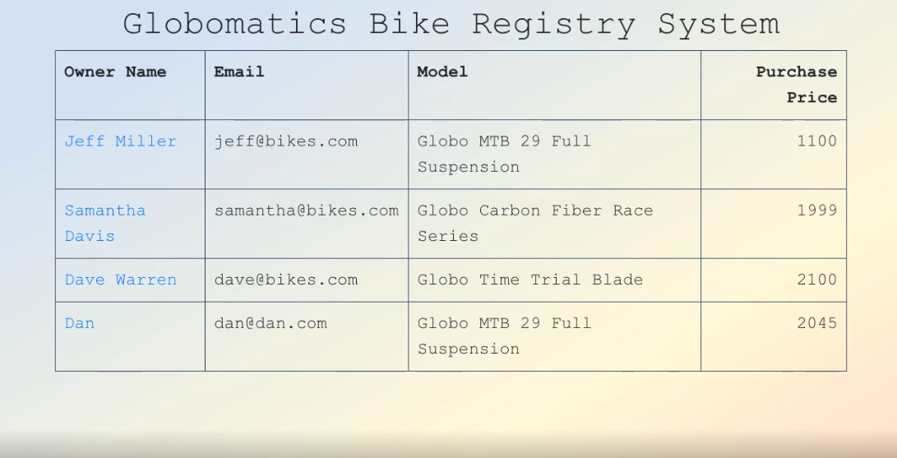
Admin Screen

Slide 10
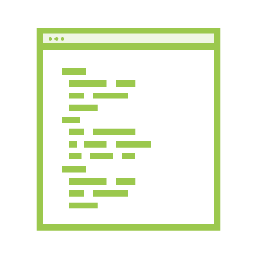
Course Overview and Expectations
Creating Your First Spring Boot Application
Angular 16
JPA, Spring Data JPA, Java, REST,
Web Components, Angular Routing, etc.

Slide 11

Spring Boot Prerequisites
•
•
•
•
Java 1.9+
Maven 3+
(http://www.oracle.com/technetwork/java/javase/downloads/index.html) (https://maven.apache.org/)
Spring Tool Suite (https://spring.io/tools/sts/all) Postman (https://www.getpostman.com/)

Slide 12
Summary
Created an app at https://start.spring.io
Added a POJO bike model Created a @RestController

